Slide 1
Software Design and Analysis CS-3004 Lecture#03
Dr. Javaria Imtiaz,
Mr. Basharat Hussain,
Mr. Majid Hussain

Slide 2
Today’s Agenda
Requirement Analysis (SDLC)
What is Use Case?
Identification of Use Cases
Use Case Diagrams
Components of Use Case Diagram
Examples
Slide 2 (of 48)
Notes:
use case diagram to depict functional requirements of a system.

Slide 3
Requirements Analysis and Use-Case Diagrams

Slide 4
How are design ideas communicated in a team environment?
If the software is large scale, employing perhaps dozens of developers over several years, it is important that all members of the development team communicate using a common language.
This isn’t meant to imply that they all need to be fluent in English or C++, but it does mean that they need to be able to describe their software’s operation and design to another person.
That is, the ideas in the head of say the analyst have to be conveyed to the designer in some way so that he/she can implement that idea in code.
Just as mathematicians use algebra and electronics engineers have evolved circuit notation and theory to describe their ideas, software engineers have evolved their own notation for describing the architecture and behaviour of software system.
That notation is called UML. The Unified Modelling Language. Some might prefer the title Universal Modelling language since it can be used to model many things besides software.

Slide 5
What is UML ?
UML is not a language in the same way that we view programming languages such as ‘C++’, ‘Java’ or ‘Basic’.
UML is however a language in the sense that it has syntax and semantics which convey meaning, understanding and constraints (i.e. what is right and wrong and the limitations of those decisions) to the reader and thereby allows two people fluent in that language to communicate and understand the intention of the other.
UML represents a collection of graphical notations to capture requirements and design alternatives.
UML is to software engineers what building plans are to an architect and an electrical circuit diagrams is to an electrician.
UML is suitable for large scale projects
Notes:
Note: UML does not work well for small projects or projects where just a few developers are involved. If you attempt to use it in this environment it will seem more of a burden than an aid, but then it was never intended for that. It works best for very complex systems involving dozens of developers over a long period of time where it is impossible for one or two people to maintain the structure of the software in their head as they develop it.

Slide 6
Phases of System Development
Requirement Analysis
The functionality users require from the system
Use-case model
OO Analysis
Discovering classes and relationships
Class diagram
OO Design
Result of Analysis expanded into technical solution
Sequence diagram, state diagram, etc.
Results in detailed specs for the coding phase
Implementation (Programming/coding)
Models are converted into code
Testing
Unit tests, integration tests, system tests and acceptance tests.

Slide 7
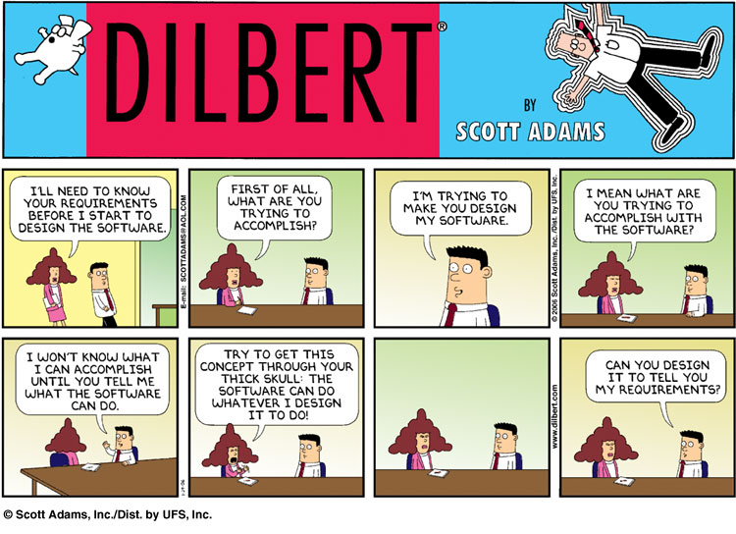

Slide 8
Definition of a Use-Case
A process or procedure, describing a user’s interaction with the system (e.g. library) for a specified, identifiable purpose. (e.g. borrowing a book).
As such, each Use-Case describes a step-by-step sequence of operations, iterations and events that document
The Interaction taking place.
The Measurable Benefits to the user interacting with the system.
The Effect of that Interaction on the system.
It is important to document these use-cases as fully as possible as each use-case captures some important functionality that our system will have to provide in the automated version of the library.
Notes:
Each use case represents a discrete goal for the user

Slide 9
Online Shopping Management system
Flex
ATM
Bank
Register Course
Withdraw Money
Apply for Loan
Make Purchase
Library
OSM
HMS
FMS
Issue Book
Make Payment
Order Food
Book Online Ticket

Slide 10
Use Cases in Iterative Development
Functional requirements are primarily captured in use cases
Use cases drive the iteration planning and work Easy for users to understand
Influence user manual/documentation
Functional or system testing corresponds to the scenarios of use cases
Independent of implementing technology UI shortcuts for most common scenarios

Slide 11
Benefits – Development Life Cycle
Use cases started for requirements become the vehicle for the following activities:
Detailing them to show the corresponding design work
Development of test plans for acceptance testing
Creation of interaction design specifics, simply by adding detail to the use cases about “how” the actions will be done
The basis for discovering a great OO design, based on the actors and their actions
Requirements
Use case
Design
Use case
Test Plan for Use Case
Notes:
E.g., The resulting system is tested “against” these easy-to-follow use cases.
So, “Is the system testable against the use cases?” is a strategic question.

Slide 12
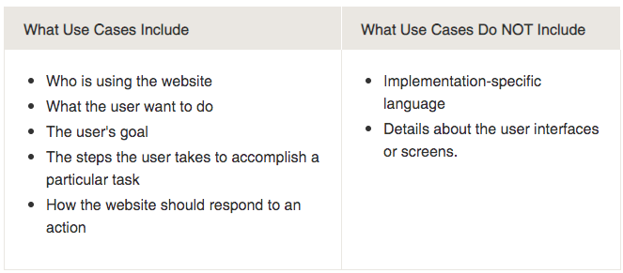
What ‘should’ and what ‘shouldn’t ‘ be included in use cases?
Notes:
They provide a list of goals and this list can be used to establish the cost and complexity of the system. Project teams can then negotiate which functions become requirements and are built.
Promote customer involvement
Help manage complexity (Layers, Focus on real user needs)
Groundwork for user manual, test cases
Help us work in iterations

Slide 13
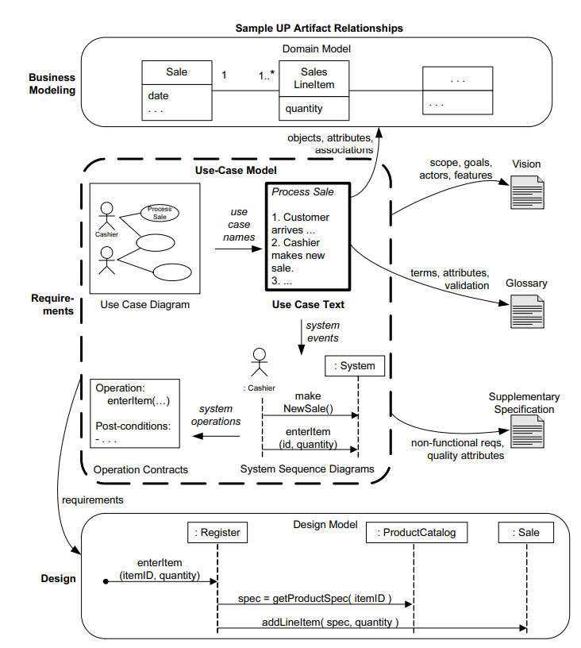

Slide 14
How to Find Use Cases?
Choose the system boundary
what you are building?
who will be using the system?
what else will be used that you are not building?
Find primary actors and their goals
brainstorm the primary actors first who starts and stops the system?
who gets notified when there are errors or failures?
Define use cases that satisfy user goals
prepare an actor-goal list (and not actor-task list) in general, one use case for each user goal
name the use case similar to the user goal

Slide 15
What Tests Can Help Find Useful Use Cases?
Which of these are valid use cases?
Negotiate a Supplier Contract
Handle Returns
Log in
Move Piece on the Game Board

Slide 16
What Tests Can Help Find Useful Use Cases?
Which of these are valid use cases?
Negotiate a Supplier Contract
Handle Returns
Log in
Move Piece on the Game Board
All of these can be use cases at different levels, depending on the system, boundary, actors, and goals

Slide 17
What Tests Can Help Find Useful Use Cases?
Rather than asking
”What is a valid use case?” More practical question:
“What is a useful level of focus to express use cases for application requirements analysis?”
Rules of thumb
The Boss Test
The EBP Test
The size test

Slide 18
What Tests Can Help Find Useful Use Cases?
The boss test
“What have you been doing all day?”
Your reply “logging in!”
Is your boss happy? No value? No good use case!
The Elementary Business Process (EBP) test
a task performed by one person in one place at one time, in response to a business event, which adds measurable business value and leaves data in a consistent state
Good Examples: Approve Credit or Price Order
Bad Examples: delete a line item or print the document
The size test
Just a single step in a sequence of others -> not good!

Slide 19
Applying Tests
Negotiate a supplier contract
Much broader than EBP, rather a business use case
Handle returns
OK with the Boss. EBP. Size is good.
Log in
Boss is not happy is this is all you do all day!
Move piece on game board
Single step – fails the size test.

Slide 20
USE CASE DIAGRAM

Slide 21
Use Case Diagram Concepts
Summarizes all use cases (for the part of the system being modeled) together in one picture.
Typically drawn early in the SDLC
Shows the associations between actors and use cases

Slide 22

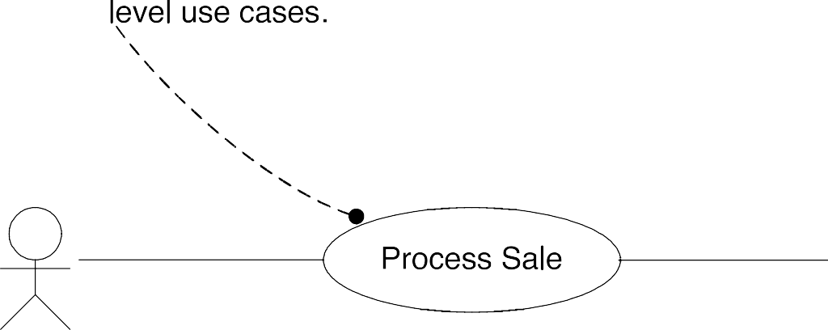

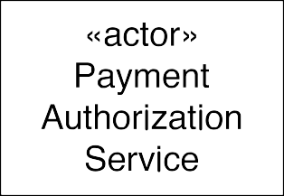


Use Case (Context) Diagrams: Suggested Notation

Slide 23
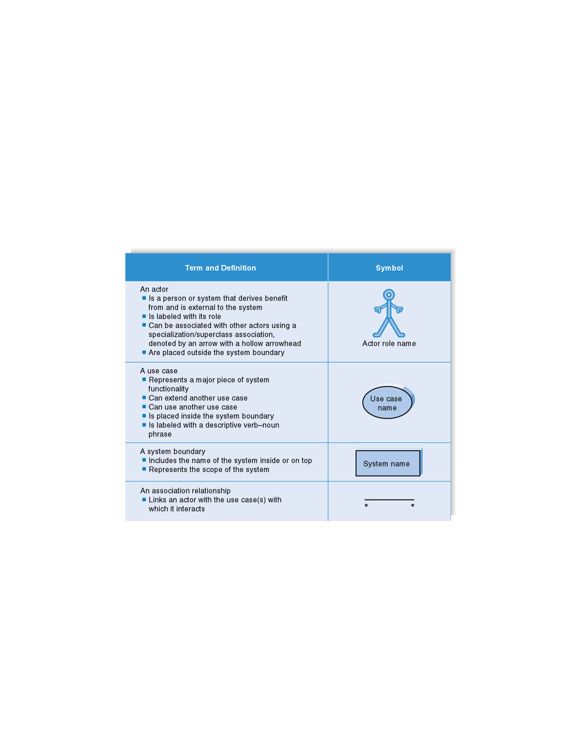

Syntax for Use Case Diagram
Notations
Name of the system

Slide 24
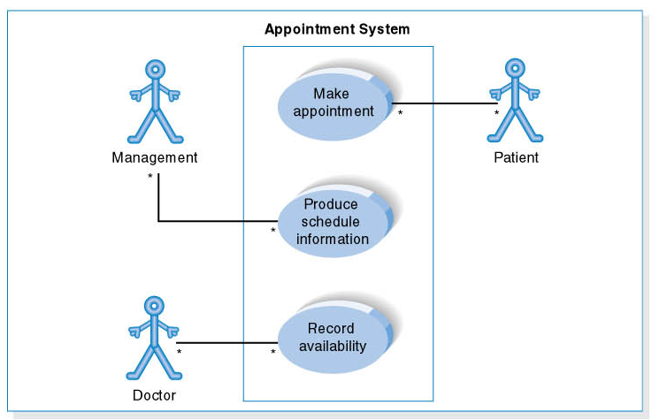
Use Case Diagram for Appointment System
Manager

Slide 25
Revision
Why to create a use case diagram?
Major components of Use case diagram
Boundary
Actor, types, place
What is use case? use cases are not diagrams, they are text
What are the three test cases use to identify the valid or invalid use cases?

Slide 26
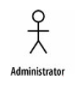
Example
The requirement indicates that that the Administrator interacts with the system to create a new blogger's account
Requirement 1
The content management system shall allow an administrator to create a new blog account, provided the personal details of the new blogger are verified using the author credentials database.
The
Administrator interacts with the system and is not part of the system; thus, the Administrator
Is an Actor.
It's actually worth being very careful when naming your actors. The best approach is to use a name that can be understood by both your customer and your system designers.

Slide 27

Example
What can be the use case in our Requirement 1?
to create a new blog account
Requirement 1
The content management system shall allow an administrator to create a new blog account, provided the personal details of the new blogger are verified using the author credentials database.
UML Representation

Slide 28
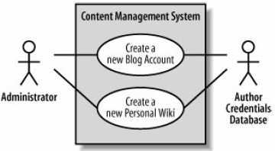
Example (Cont)
Requirement 2
The content management system shall allow an administrator to create a new personal Wiki, provided the personal details of the applying author are verified using the Author Credentials Database.

Slide 29
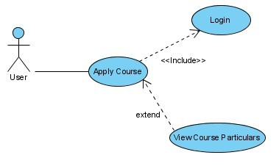
Example – Include and Extend
UML SIG
"The include relationship is intended for reusing behavior modeled by another use case, whereas the extend relationship is intended for adding parts to existing use cases as well as for modeling optional system services"
Slide 2 (of 48)

Slide 30
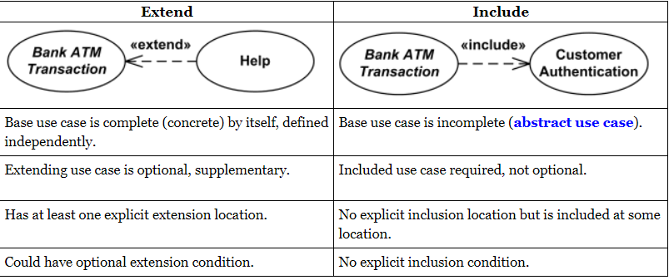
Include and Extend Relationships

Slide 31
Include and Extend
The use of include and extend is discouraged simply because they add unnecessary complexity to a Use Case diagram.
Since the primary purpose of use cases is to show user centered functionality, the precedence of use cases takes little importance.
Slide 2 (of 48)

Slide 32
Use Case Diagram– Guidelines & Caution
Actors should be Use cases should ideally begin with a verb – i.e generate report.
Use cases should NOT be open ended – i.e Register (instead should be named as Register New User)
Avoid showing communication between actors.
named as singular. i.e., student and NOT students. NO names should be used – i.e John, Sam, etc.
Do NOT show behavior in a use case diagram; instead only depict only system functionality.
Use case diagram does not show sequence – unlike DFDs.

Slide 33
Granularity of Use Cases
Add reference
Remove reference
User
Search for reference
List references

Slide 34
Granularity of Use Cases
Manage Reference
User
Generally, a use case should embody sufficient levels of granularity without which the use case may not be rendered as useful.

Slide 35
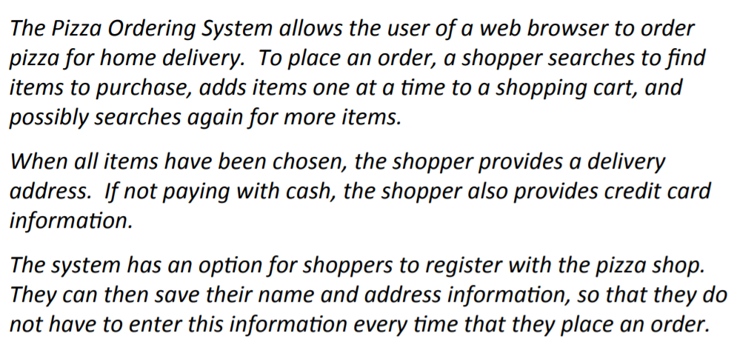
Pizza Ordering System

Slide 36
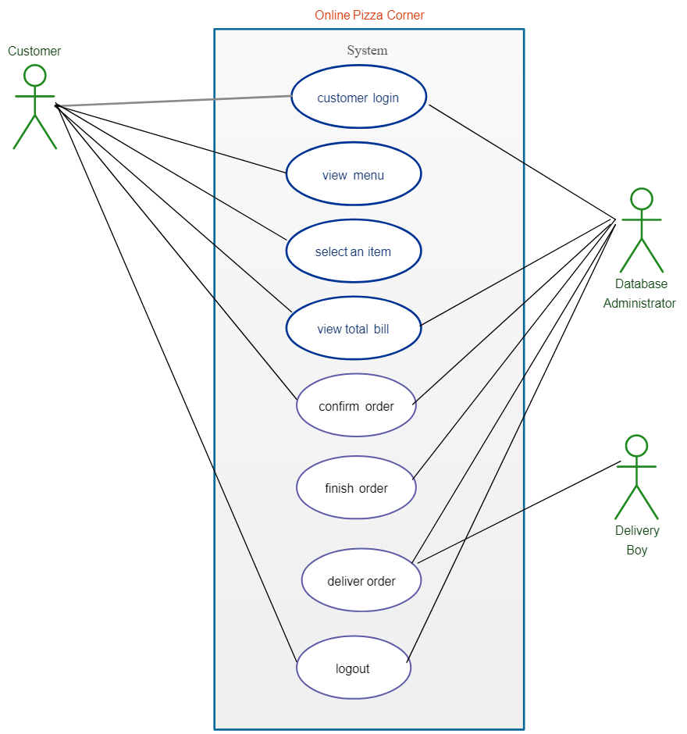
Pizza Ordering System
Place Order
PaybyCredit

Slide 37
Revision
How to find Use Cases
Choose a system boundary : Everything outside SuD, easy to find once external actors are identifies
Identify Actors: Actual Person, Something you cannot change in a SuD
Identify User Goals
Define Use Cases

Slide 38
Library Management System
Any library member should be able to search books by their title, author, subject category as well by the publication date. Each book will have a unique identification number and other details including a rack number which will help to physically locate the book. There could be more than one copy of a book, and library members should be able to check-out and reserve any copy. We will call each copy of a book, a book item. The system should be able to retrieve information like who took a particular book or what are the books checked-out by a specific library member. There should be a maximum limit (5) on how many books a member can check-out. There should be a maximum limit (10) on how many days a member can keep a book. The system should be able to collect fines for books returned after the due date. Members should be able to reserve books that are not currently available. The system should be able to send notifications whenever the reserved books become available, as well as when the book is not returned within the due date. Each book and member card will have a unique barcode. The system will be able to read barcodes from books and members’ library cards.

Slide 39
Requirements
Any library member should be able to search books by their title, author, subject category as well by the publication date.
Each book will have a unique identification number and other details including a rack number which will help to physically locate the book.
There could be more than one copy of a book, and library members should be able to check-out and reserve any copy. We will call each copy of a book, a book item.
The system should be able to retrieve information like who took a particular book or what are the books checked-out by a specific library member.
There should be a maximum limit (5) on how many books a member can check-out.
There should be a maximum limit (10) on how many days a member can keep a book.
The system should be able to collect fines for books returned after the due date.
Members should be able to reserve books that are not currently available.
The system should be able to send notifications whenever the reserved books become available, as well as when the book is not returned within the due date.
Each book and member card will have a unique barcode. The system will be able to read barcodes from books and members’ library cards.

Slide 40
Requirements
Any library member should be able to search books by their title, author, subject category as well by the publication date.
Each book will have a unique identification number and other details including a rack number which will help to physically locate the book.
There could be more than one copy of a book, and library members should be able to check-out and reserve any copy. We will call each copy of a book, a book item.
The system should be able to retrieve information like who took a particular book or what are the books checked-out by a specific library member.
There should be a maximum limit (5) on how many books a member can check-out.
There should be a maximum limit (10) on how many days a member can keep a book.
The system should be able to collect fines for books returned after the due date.
Members should be able to reserve books that are not currently available.
The system should be able to send notifications whenever the reserved books become available, as well as when the book is not returned within the due date.
Each book and member card will have a unique barcode.
The system will be able to read barcodes from books and members’ library cards.

Slide 41
Actors
Librarian: Mainly responsible for adding and modifying books, book items, and users. The Librarian can also issue, reserve, and return book items.
Patron: All members can search the catalog, as well as check-out, reserve, renew, and return a book.

Slide 42
User Goals
Add/Remove/Edit book: To add, remove or modify a book or book item.
Search catalog: To search books by title, author, subject or publication date.
Register new account/cancel membership: To add a new member or cancel the membership of an existing member.
Check-out book: To borrow a book from the library.
Reserve book: To reserve a book which is not currently available.
Renew a book: To reborrow an already checked-out book.
Return a book: To return a book to the library which was issued to a member.

Slide 43
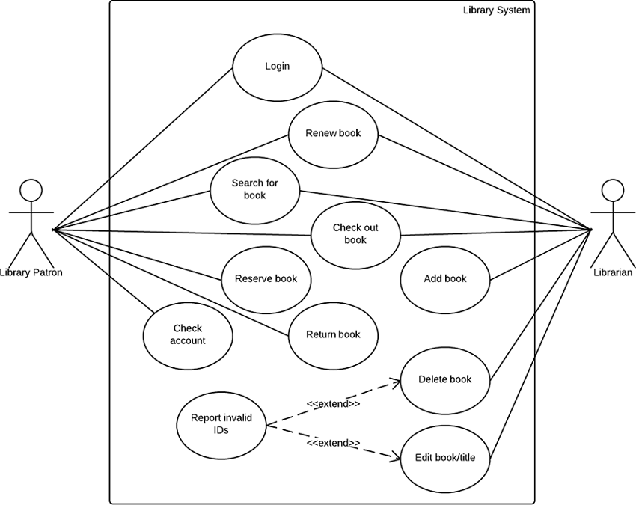
Use Case Diagram for Library Management System
Create Account

Slide 44
Case
Identify Actors
Driver and hostess cannot be an Actor. Why?
Driver
Hostess
Customer
Company Staff/ Administrator
Consider an online reservation system for a bus company. The bus company includes several buses and manage trips to different cities. Each bus is identified by its plate number and a separately assigned bus number. The trips are based on a predefined schedule and stop at predefined bus stations. Each bus can have only one trip per day. Each bus includes a driver and one hostess. For long trips, the bus will have breaks at service and rest areas. There are two types of trips, normal trips and express trips. Express trips do not stop at intermediate stations and get faster at the destination. Seats can be reserved by customers on the web site of the bus company. The customer has the option to directly pay for the seat through the website. In that case, the seat cannot be cancelled (neither by the customer nor by the bus company). If the customer has not paid for the seat, the bus company can cancel the seat if the customer does not show up one hour before the trip. When the reservation is cancelled, the seat will become free and can be sold to another customer. Both the customer and the company staff must authenticate themselves for performing operations with the system.

Slide 45
Case
Identify Verb / Goal/Use Case
Reserve Seat
Pay for the Seat
Cancel Seat
Register
View Seat
Consider an online reservation system for a bus company. The bus company includes several buses and realizes trips to different cities. Each bus is identified by its plate number and a separately assigned bus number. The trips are based on a predefined schedule and stop at predefined bus stations. Each bus can have only one trip per day. Each bus includes a driver and one hostess. For long trips, the bus will have breaks at service and rest areas. There are two types of trips, normal trips and express trips. Express trips do not stop at intermediate stations and get faster at the destination. Seats can be reserved by customers on the web site of the bus company. The customer has the option to directly pay for the seat through the website. In that case, the seat cannot be cancelled (neither by the customer nor by the bus company). If the customer has not paid for the seat, the bus company can cancel the seat if the customer does not show up one hour before the trip. When the reservation is cancelled, the seat will become free and can be sold to another customer. Both the customer and the company staff must authenticate themselves for performing operations with the system.

Slide 46
So far what we have
Actors
Customer
Bus Company Administrator
Use Cases
Reserve Seat
Pay for the Seat
Cancel Seat
Register
View Seat
Start Making a Use Case Diagram with the identified information

Slide 47
Case
Actor Goals?
Complete the Use Case Diagram
Customer Reserves the Seat
Customer Pays for the Seat
Customer & Admin Cancels the Seat
Customer & Admin must Register
Customer & Admin can View the Seat
Consider an online reservation system for a bus company. The bus company includes several buses and realizes trips to different cities. Each bus is identified by its plate number and a separately assigned bus number. The trips are based on a predefined schedule and stop at predefined bus stations. Each bus can have only one trip per day. Each bus includes a driver and one hostess. For long trips, the bus will have breaks at service and rest areas. There are two types of trips, normal trips and express trips. Express trips do not stop at intermediate stations and get faster at the destination. Seats can be reserved by customers on the web site of the bus company. The customer has the option to directly pay for the seat through the website. In that case, the seat cannot be cancelled (neither by the customer nor by the bus company). If the customer has not paid for the seat, the bus company can cancel the seat if the customer does not show up one hour before the trip. When the reservation is cancelled, the seat will become free and can be sold to another customer. Both the customer and the company staff must authenticate themselves for performing operations with the system.

Slide 48

One Possible Solution for the Case
Bus Reservation System
Pay for Seat
Bus Reservation System
Cancel Seat
Customer
Reserve Seat
Register
Bus Company Admin
View Seats
Manage Trips

Slide 49
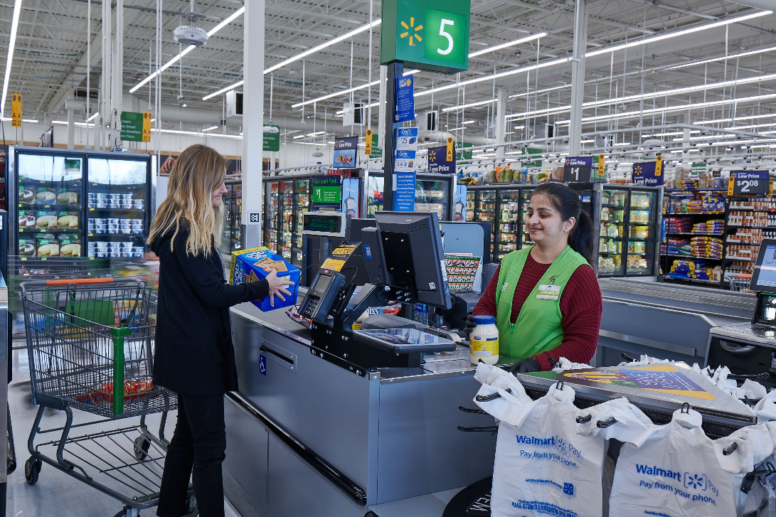
Process Sale:
A customer arrives at a checkout with items to purchase. The cashier uses the POS system to record each purchased item. The system presents a running total and line-item details. The customer enters payment information, which the system validates and records. The system updates inventory. The customer receives a receipt from the system and then leaves with the items.

Slide 50
Actors and User Goals
Actor | Goal | Actor | Goal
Cashier | Process sales Process rentals Handle returns Cash in Cash out … | System Administrator | Add users Modify users Delete users Manage security Manage system tables
Manager | 1. Start up 2. Shut down | Sales Activity System | 1. Analyze sales and performance data
… | … | … | …

Slide 51
